Slide 1
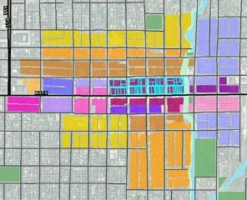
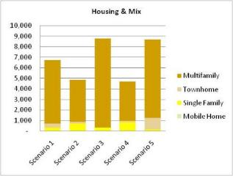
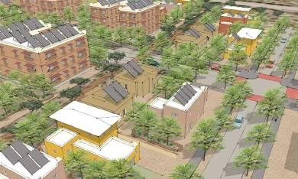
Scenario Planning with Envision Tomorrow
www.frego.com

Slide 2
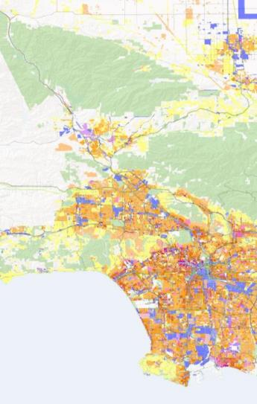
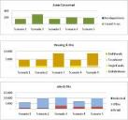
What is Envision Tomorrow?
Suite of planning tools:
Prototype Builder
Return on Investment (ROI) model
Scenario Builder
Extension for ArcGIS

Slide 3
What is Envision Tomorrow?
Suite of planning tools:
Prototype Builder
Return on Investment (ROI) model
Scenario Builder
Extension for ArcGIS

Slide 4
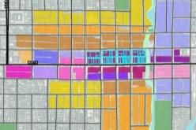
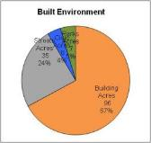
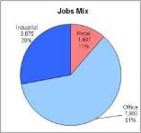
Scenario Builder: Scenario Painter for ArcGIS
Buildings
Quickly paint scenarios using financially feasible building blocks
Compare multiple scenarios across variety of indicators
Track progress in real-time
Scenarios
Indicators

Slide 5
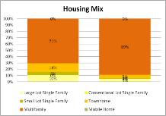
A Linked System of Spreadsheets and GIS
GIS
Painting ArcGIS
Buildings
ROI Model
Development Types
Scenario Spreadsheet
Evaluation Criteria
Scenario Spreadsheet
5 Story Mixed Use
Density & Mix
Travel
Health
Sustainability
Investment
Fiscal Impact
Town Center
2 Story Mixed Use
3 Story Apartment
Town Neighborhood
Townhome
Compact Single Family
Residential Subdivision
Conventional Single Family

Slide 6
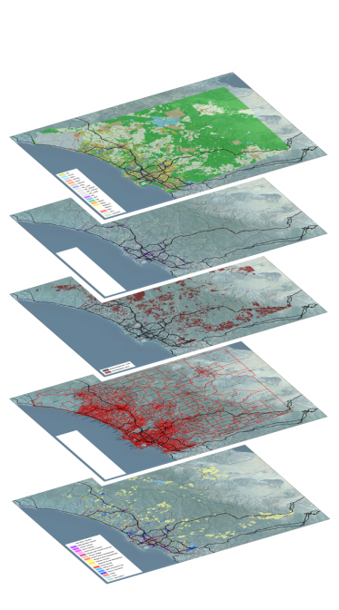
Data collection
Forecast: housing units and jobs
Buildable lands supply
Vacant & Infill
Existing & Planned Land Use
Environmental constraints
Existing and Planned Roads and Transit

Slide 7
Buildable Lands Layer Concept
Basic Envision Tomorrow function requires a buildable land supply
Buildable Land
Land Supply
Constraints
-
=

Slide 8
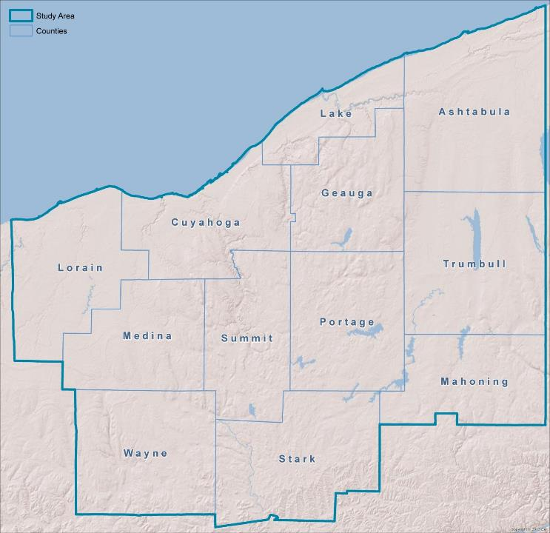
Map Build

Slide 9
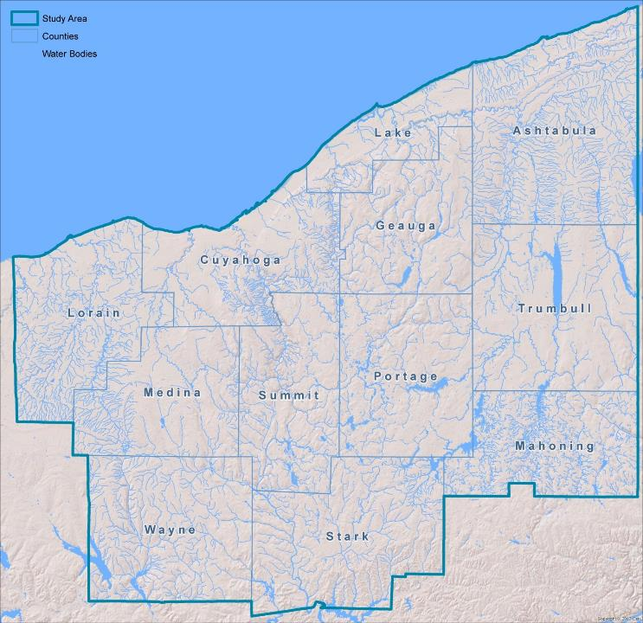
Map Build

Slide 10
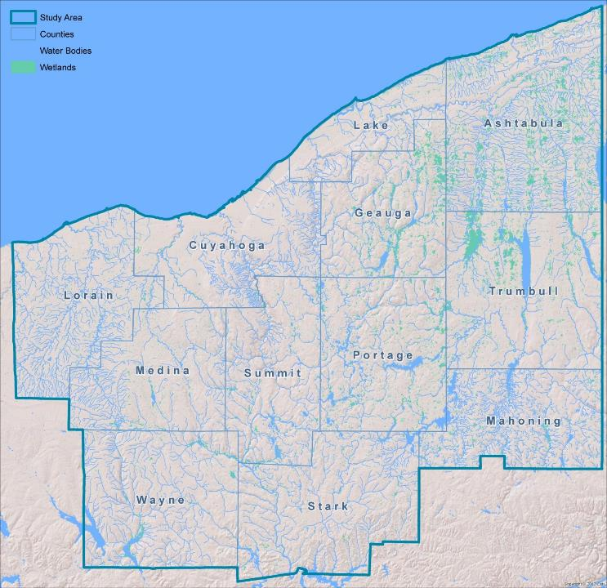
Map Build

Slide 11
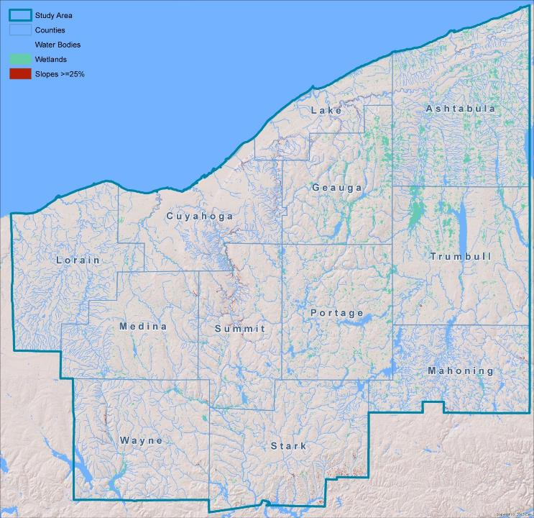
Map Build

Slide 12
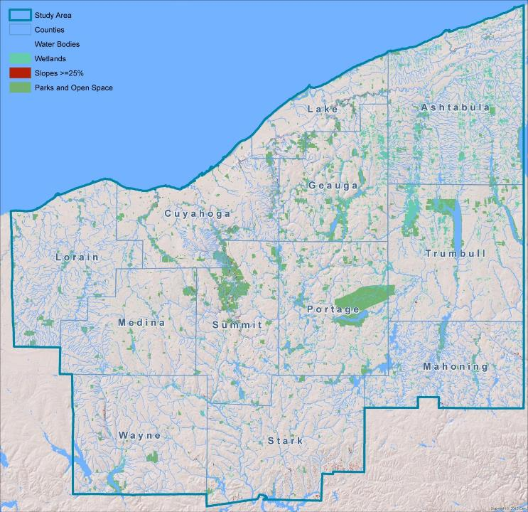
Map Build

Slide 13
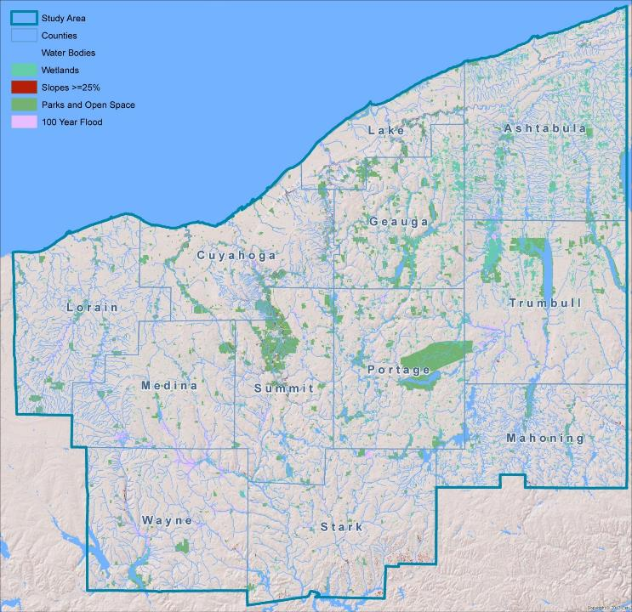
Map Build

Slide 14
Map Build

Slide 15
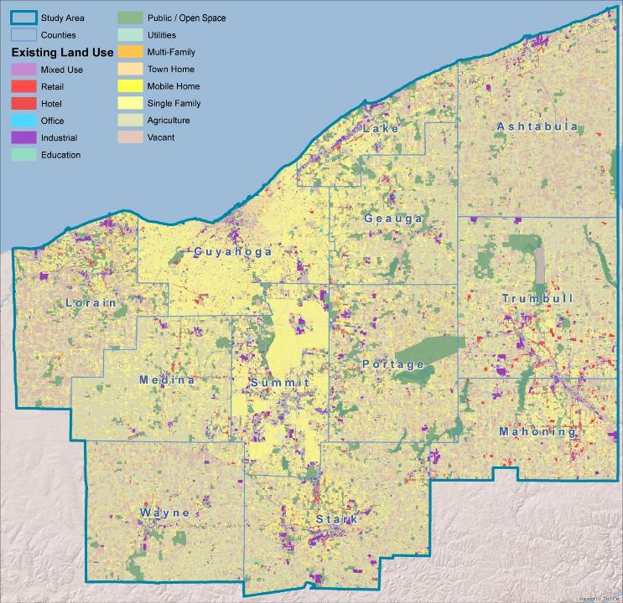

Slide 16
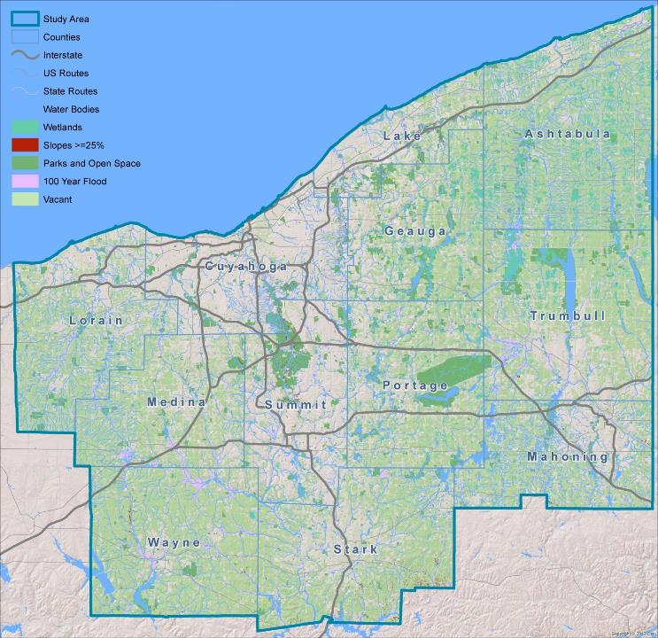
Map Build

Slide 17
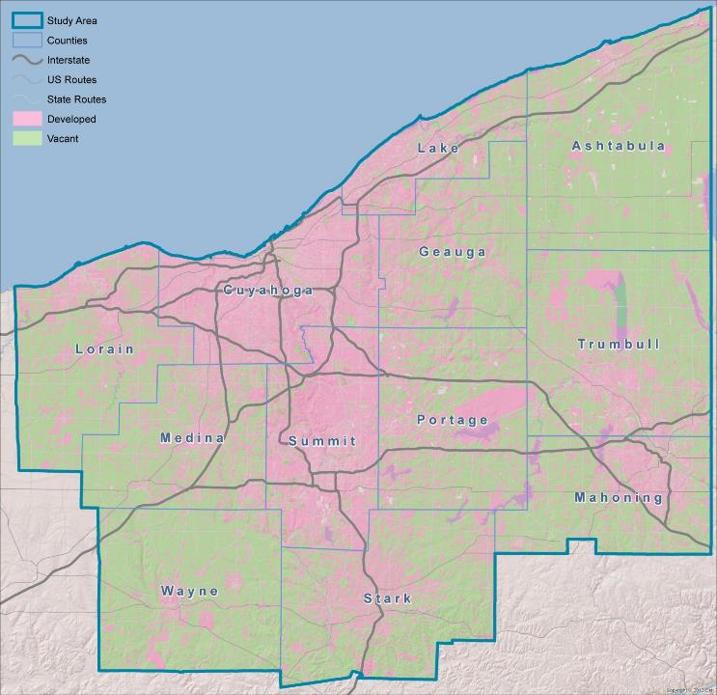
Map Build

Slide 18
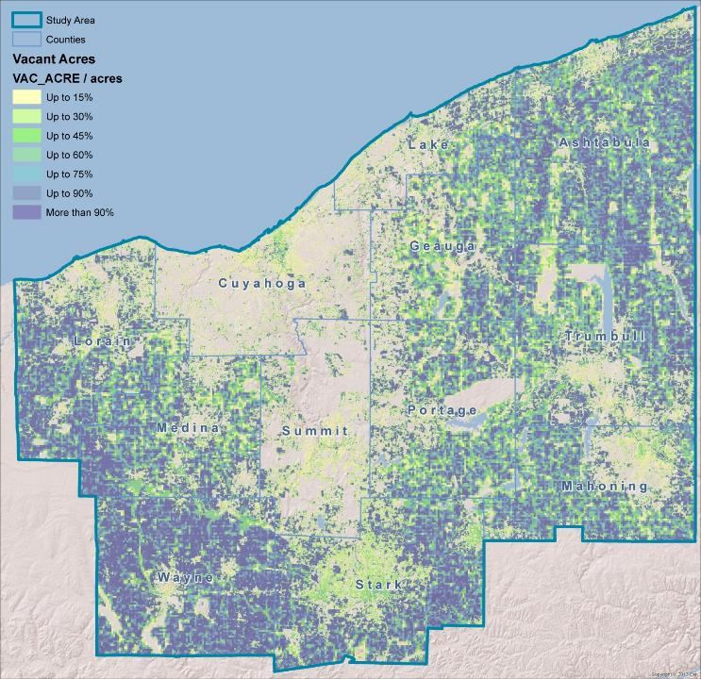
Map Build

Slide 19
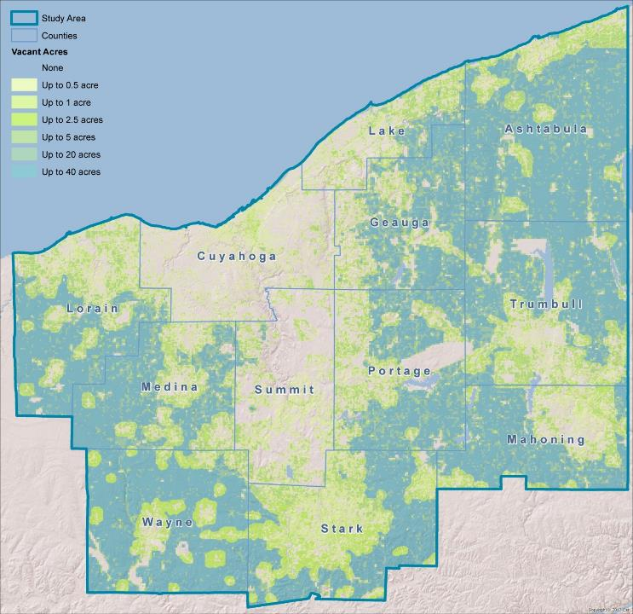
Map Build

Slide 20
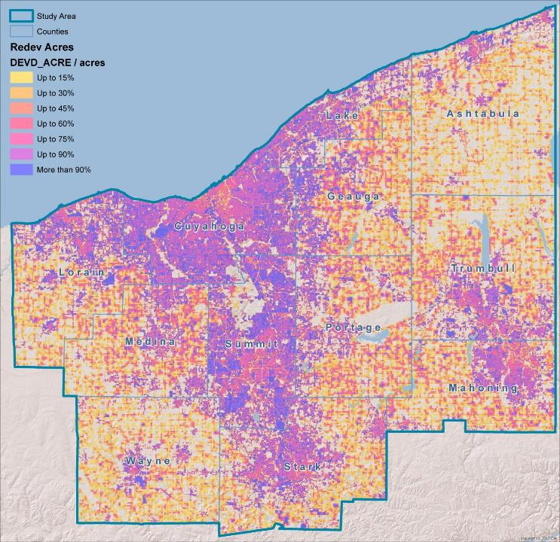
Map Build

Slide 21
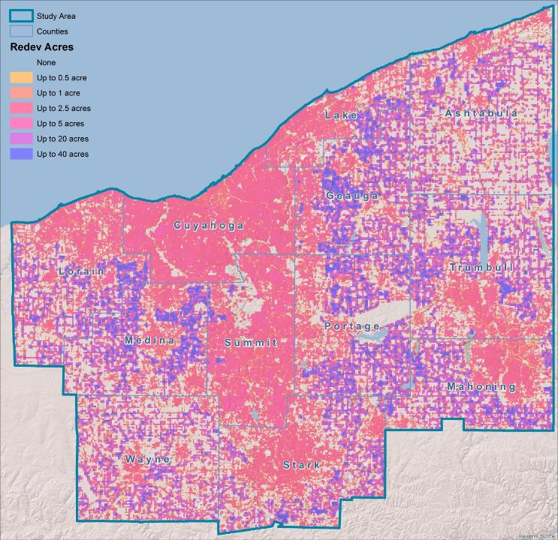
Map Build

Slide 22
File Structure
Prototype Building (ROI) Spreadsheet library
Standard ROI template
Up to 30 building types
Each an individual Excel file
Scenario Spreadsheet
Standard Template
Building inputs loaded here
Additional district-level assumptions made
Street characteristics, parks, civic uses
Mix of buildings
File Geodatabase
Scenario polygon layers (ie- parcels, uniform grid, Census Blocks, TAZs)
“Development_Type_Attributes” lookup table (copied from Dev Type Attributes tab in Scenario Spreadsheet)
“Envision_DevType_Field_Tracking” table
“Scenario1-5” tables: Scenario output tables
“Scenario_Summary” table

Slide 23
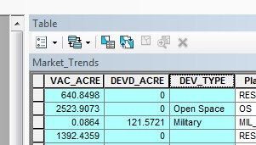
Only 3 Required GIS Fields
3 GIS fields drive most calculations
Dev Type Attributes + Land Capacity = Results
VAC_ACRE
DEVD_ACRE
DEV_TYPE
Vacant acres available in the polygon
Developed acres available for redevelopment in the polygon
Development Type Name

Slide 24
Envision Calculations
7
acre
2
acre
Vacant Acre
1
acre
Developed Acre
7 Vacant Acres
X
Dev Type Density
+
=
New Housing Units
3 Developed Acres
X
Redevelopment Rate
Dev Type Density
X

Slide 25
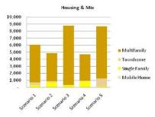
Scenario Building Process
Building Types
Development Types
Scenario Development
Evaluation
1
Step 1: Model a library of building types that are financially feasible at the local level.

Slide 26
Scenario Building Process
Building Types
Development Types
Scenario Development
Evaluation
2
Step 2: Define the buildings, streets and amenities that make up all the “places” in which we live, work and play.

Slide 27
Scenario Builder Exercise
Open any browser
http://tinyurl.com/envisiontomorrow

Slide 28
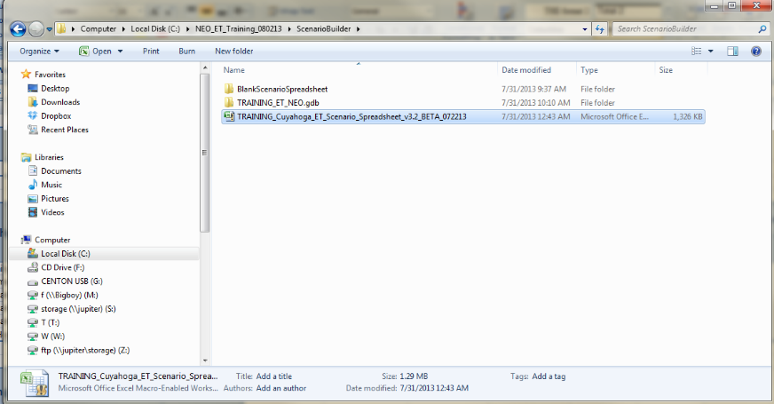
Scenario Builder Exercise
Scenario Spreadsheet

Slide 29
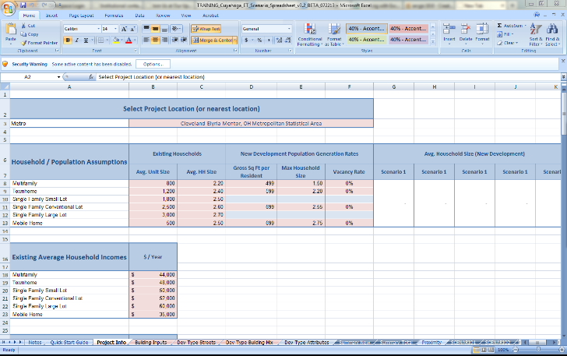
Scenario Builder Exercise
Project Info

Slide 30
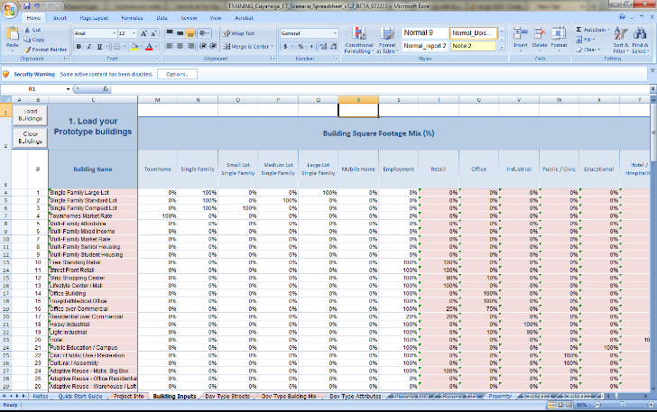
Scenario Builder Exercise
Building Inputs

Slide 31
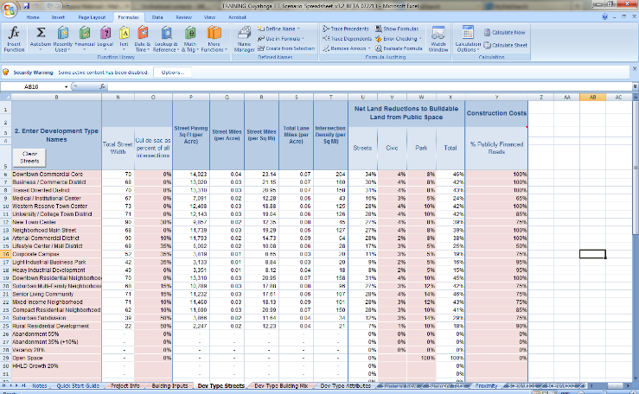
Scenario Builder Exercise
Development Type Streets

Slide 32
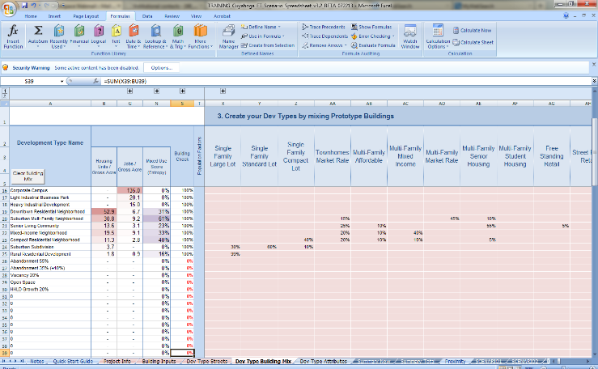
Scenario Builder Exercise
Development Type Building Mix

Slide 33
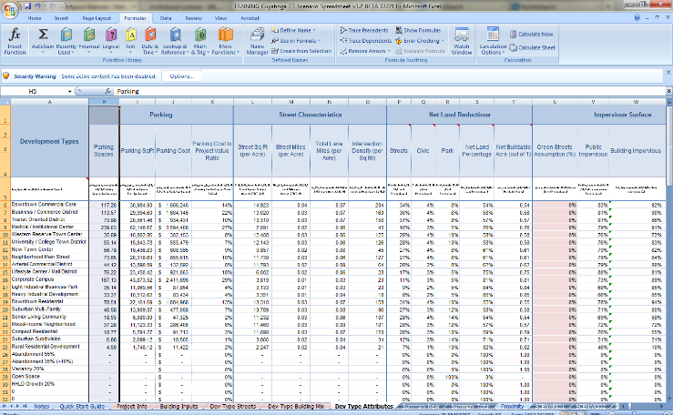
Scenario Builder Exercise
Development Type Attributes

Slide 34
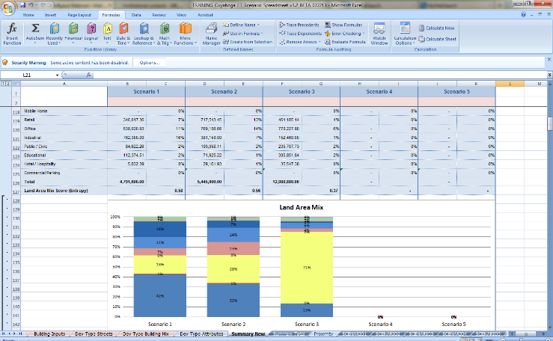
Scenario Builder Exercise
Comparing Scenarios - Summary New

Slide 35
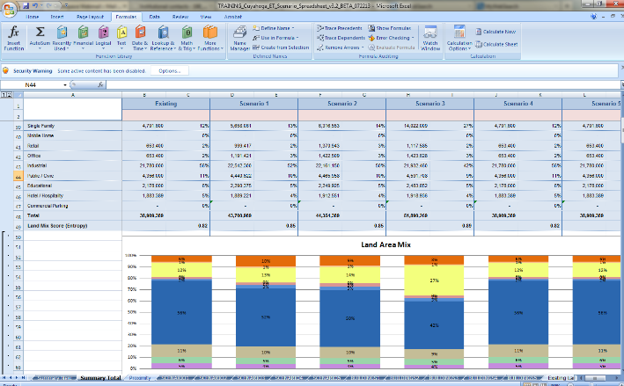
Scenario Builder Exercise
Comparing Scenarios - Summary Total

Slide 36
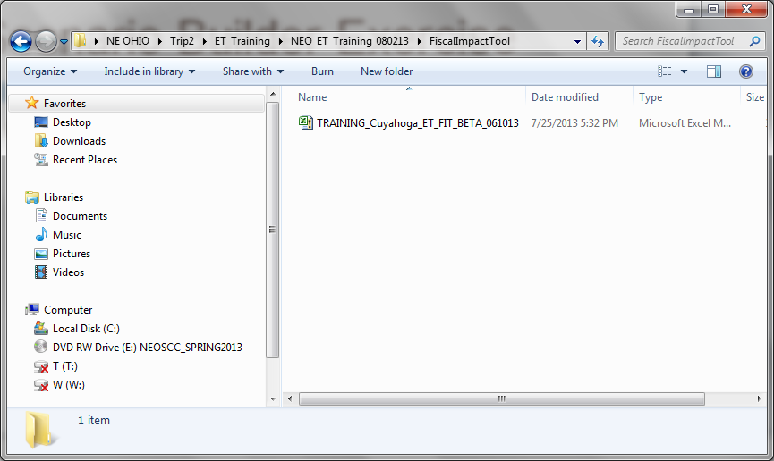
Scenario Builder Exercise
Open FIT module

Slide 37
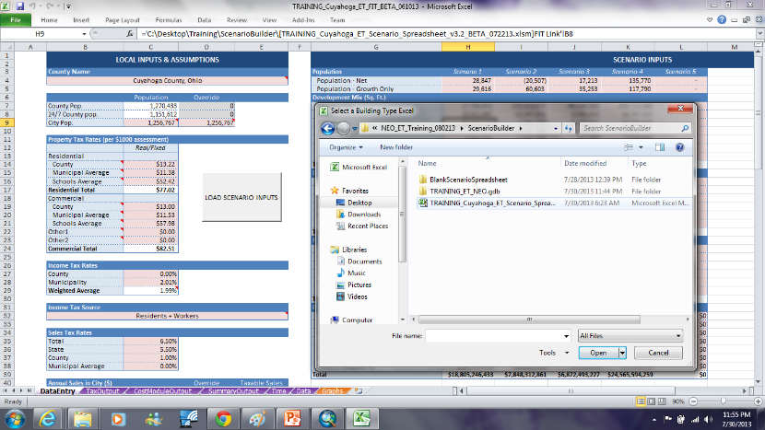
Scenario Builder Exercise
Link scenario spreadsheet

Slide 38
Scenario Builder Exercise
Save and close

Slide 39
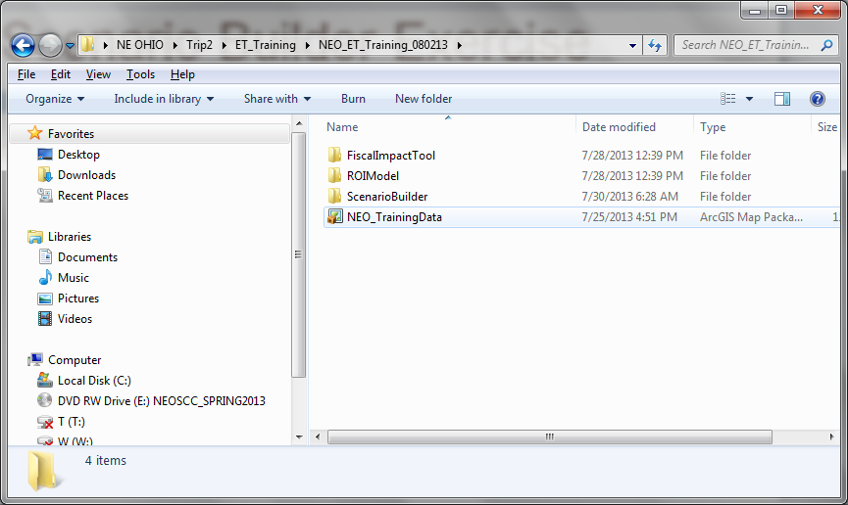
Scenario Builder Exercise
Open map package

Slide 40
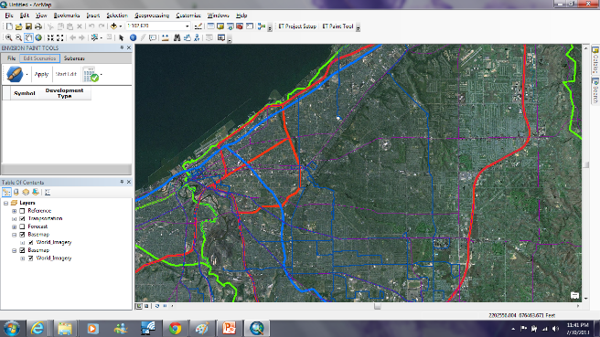
Scenario Builder Exercise
Open map package

Slide 41
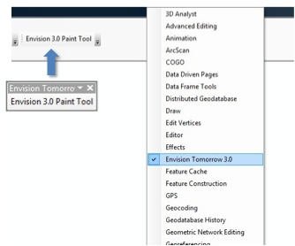
Scenario Builder Exercise
Load Envision Tomorrow toolbar

Slide 42
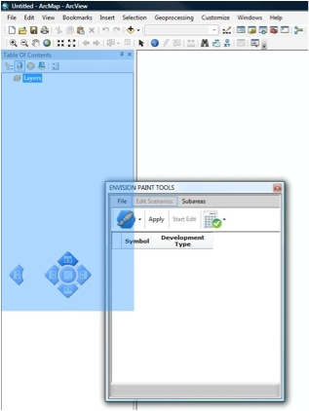
Scenario Builder Exercise
Open and dock ET window

Slide 43
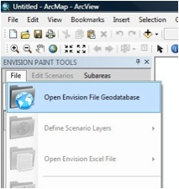
Scenario Builder Exercise
Load scenario geodatabase

Slide 44
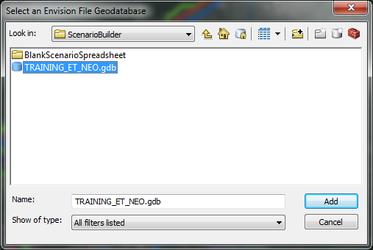
Scenario Builder Exercise
Load scenario geodatabase

Slide 45
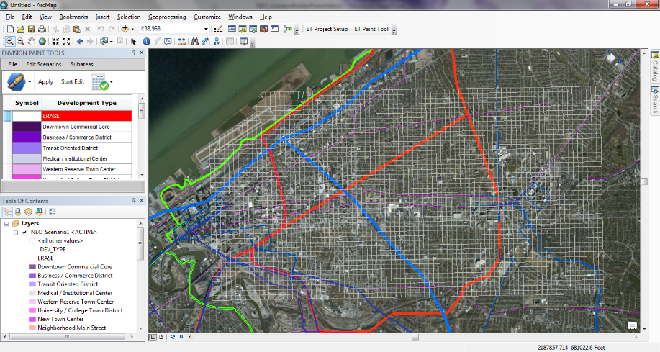
Scenario Builder Exercise

Slide 46
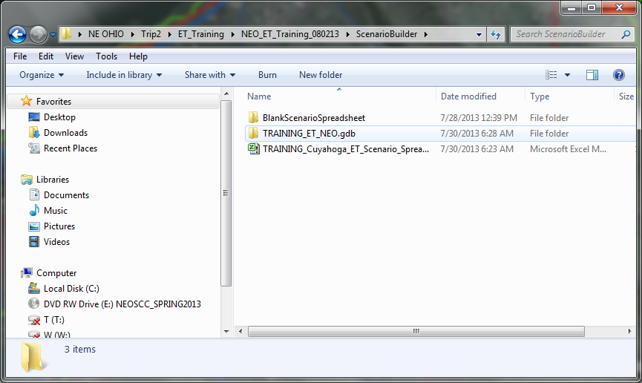
Scenario Builder Exercise
Load scenario excel spreadsheet

Slide 47
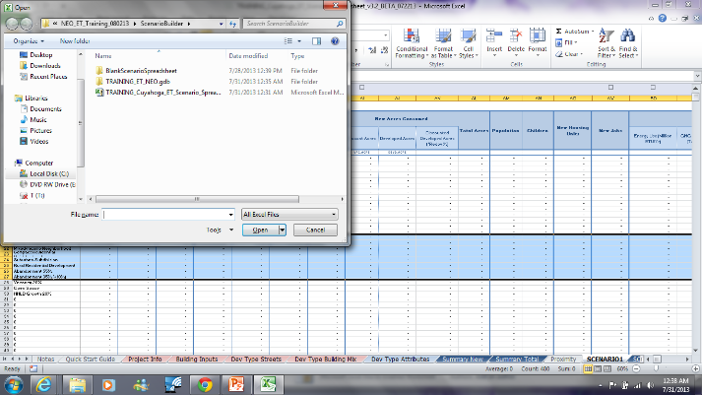
Scenario Builder Exercise
Re-open FIT module through scenario spreadsheet

Slide 48
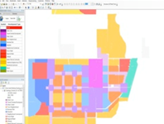
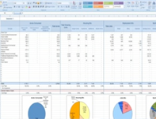
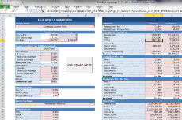
Linked GIS and Spreadsheets
SCENARIO SPREADSHEET
FIT MODULE

Slide 49
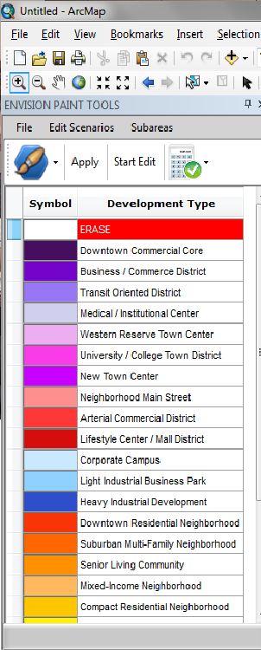
Scenario Builder Exercise
SCENARIO SELECTION
PAINT BRUSH SELECTION
EDIT SESSION
SELECT - APPLY
ERASE
DEVELOPMENT TYPE PALETTE

Slide 50
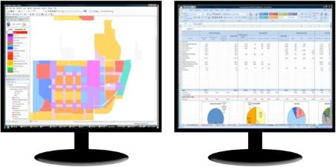
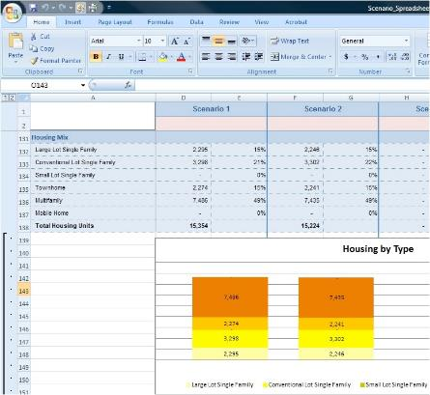
Scenario Builder Exercise
Track results in real-time

Slide 51
Scenario Builder Exercise
Start edit session
EDIT SESSION

Slide 52
Scenario Builder Exercise
Goal: add by painting
20,000 Jobs
15,000 People
PAINT BRUSH SELECTION
SELECT - APPLY

